Slide 1

Graph Theory
Dipti Jain

Slide 2


Let's know each other

Slide 3
Course Objectives
CO1: model problems using different types of basic graphs like trees, bipartite graphs and planar graphs.
1
CO2: understand and identify special graphs like Euler graphs and Hamiltonian graphs.
2
CO3: have increased ability to understand various forms of connectedness in a graph
3
CO4: appreciate different graph-coloring problems and their solutions.
4
CO5: to model simple problems from real life as graph-coloring problems.
5

Slide 4
Syllabus MCAE-502

Slide 5

Syllabus:
Unit-I Fundamental Concepts:
Definitions, examples of problems in graph theory, adjacency and incidence matrices, isomorphisms, paths, walks, cycles, components, cut-edges, cut-vertices, bipartite graphs, eulerian graphs, vertex degrees, reconstruction conjecture, extremal problems, degree sequences, directed graphs, de Bruijn cycles, Orientations and tournaments.
Unit-II Trees:
Trees and forests, characterizations of trees, spanning trees, radius and diameter, enumeration of trees, Cayley’s formula, Prüfer code, counting spanning trees, deletion-contraction, the matrix tree theorem, graceful labelling, minimum spanning trees (Kruskal’s algorithm), shortest paths (Dijkstra’s algorithm).

Slide 6
Unit-III Matching and Covers:
Matchings, maximal and maximum matchings, M-augmenting paths, Hall's theorem and consequences, Min-max theorems, maximum matchings and vertex covers, independent sets and edge covers, Connectivity, vertex cuts, Edge-connectivity.
Unit-IV Connectivity and Paths:
Blocks, k-connected graphs, Menger’s theorem, line graphs, network flow problems, flows and source/sink cuts, Ford-Fulkerson algorithm, Max-flow min-cut theorem.

Slide 7
Unit-V Graph Coloring:
Vertex colorings, bounds on chromatic numbers, Chromatic numbers of graphs constructed from smaller graphs, chromatic polynomials, properties of the chromatic polynomial, the deletion-contraction recurrence.
Unit-VI Planar Graphs:
Planar graphs, Euler's formula, Kuratowski's theorem, five and four color theorems.

Slide 8
What do you know about graphs?

Slide 9
Traveling Salesman Problem
Breadth First Search
Depth First Search
Kruskal’ s algorithm
Dijkstra
Network flow

Slide 10
Why do we need to study graph theory? Or why would anybody study graphs?

Slide 11
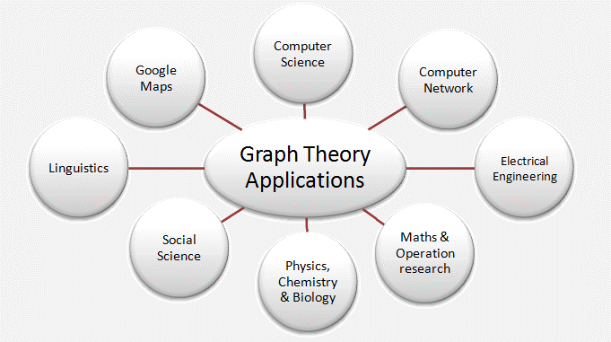
It is a branch of computer science used to model and study different situations
It is the study of graphs, which are mathematical structures used to model pairwise relation between the objects

Slide 12
Applications of Graph Theory in Computer Science
In computer science graph theory is used for the study of algorithms like:
Dijkstra's Algorithm
Prims' Algorithm
Kruskal's Algorithm
Graphs are used to define the flow of computation.
Graphs are used to represent networks of communication.
Graphs are used to represent data organization.

Slide 13
Graph transformation systems work on rule-based in-memory manipulation of graphs. Graph databases ensure transaction-safe, persistent storing and querying of graph structured data.
Graph theory is used to find shortest path in road or a network.
In Google Maps, various locations are represented as vertices or nodes and the roads are represented as edges and graph theory is used to find the shortest path between two nodes.

Slide 14

There is a large warehouse consisting of thousands of different items in various locations . The challenge is that given a list of items which path should you follow through the warehouse to pickup all the items but at the same time minimize the total distance travelled?
The point is solving a problem as complex as above, modeling the situations as series of nodes and interconnected paths gives a visual aspect to our problem-solving approach.

Slide 15
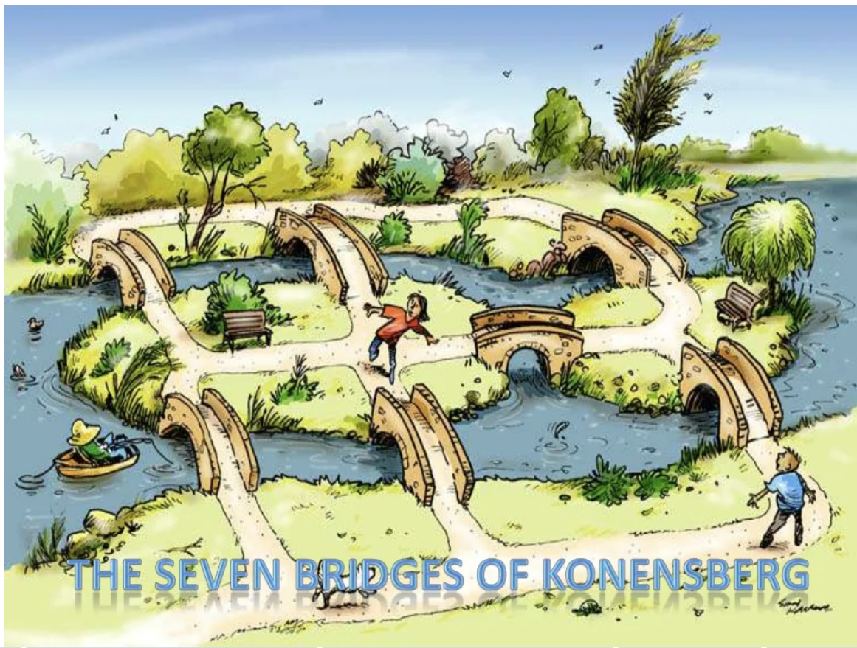
History of Graph Theory (How did it all start?)
Believe me it is not
boring

Slide 16
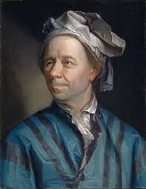

Königsberg Bridge Problem
The Seven Bridges of Königsberg is a historically notable problem in
mathematics. Its negative resolution by Leonhard Euler in 1736 laid the
foundations of graph theory and prefigured the idea of topology.
The city of Königsberg in Prussia (now Kaliningrad, Russia) was set on both sides of the Pregel River and included two large islands—Kneiphof and Lomse—which were connected to each other, and to the two mainland portions of the city, by seven bridges. The problem was to devise a walk through the city that would cross each of those bridges once and only once.

Slide 17
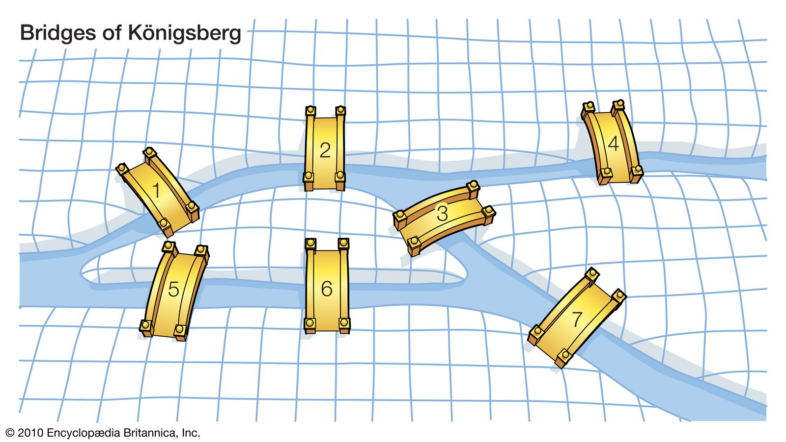
“Starting from any of the four land areas A, B, C, D, is it possible to cross each of the seven bridges exactly once and come back to the starting point without swimming across the river?”

Slide 18
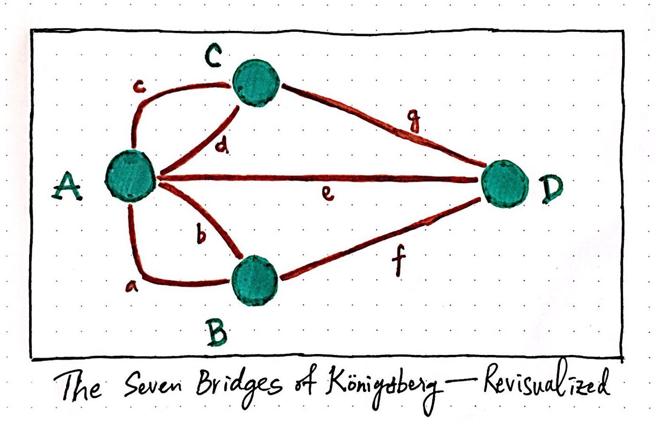
In 1735,
A Swiss Mathematician Leon hard Euler solved this problem.
He provided a solution to the problem and finally concluded that such a walk is not possible.
Euler represented the given situation using a graph as shown below-
Euler observed that when a vertex is visited during the process of tracing a graph-
There must be one edge that enters into the vertex.
There must be another edge that leaves the vertex.
Therefore, order of the vertex must be an even number.

Slide 19
Fundamentals

Slide 20
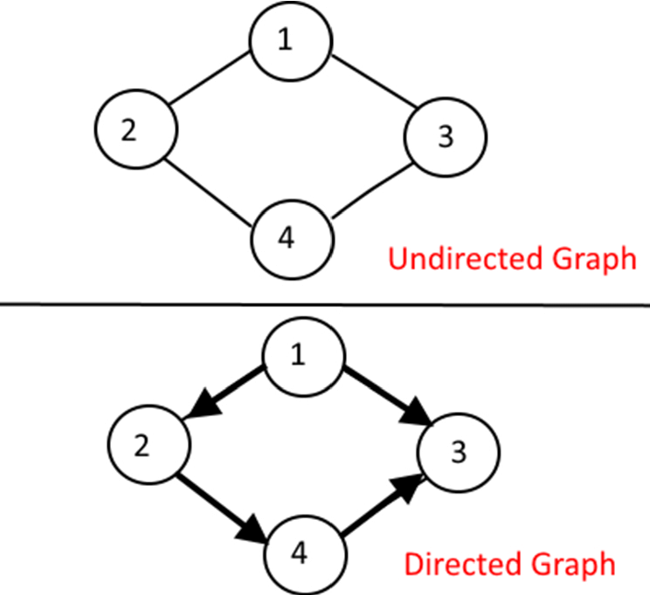

Graph(undirected graph):
An undirected graph G(V,E) id defined abstractly as an ordered pair (V,E) where –
V is a set of points called vertices
E is a set of multisets of two elements from V
Example :

Slide 21
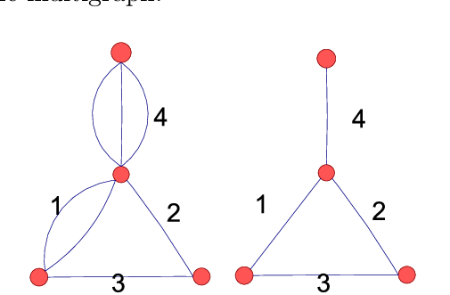
Simple Graph:
A graph G(V,E) is a simple graph if the edge set E is unordered pair of distinct vertices. A simple graph has no multiple edges or loops.
Multigraph:
A graph G(V,E) is a multigraph where the edge set E is a multiset of two elements from V.

Slide 22
Directed Graph / Digraph:
A directed graph G(V,E) is defined abstractly as an ordered pair (V,E) where –
V is a set of points called vertices
E is a binary relation on E
Example :

Slide 23
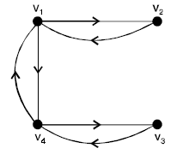
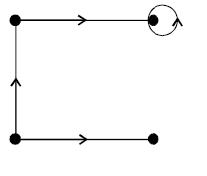
Symmetric Digraph:
Digraphs in which for each edge (x,y) there is also an edge (y,x)
in the edge set are symmetric digraphs
Asymmetric Digraph:
Digraphs having only one directed edge between each pair of vertices but can have self loops are called Asymmetric digraphs.

Slide 24
Finite Graph:
A multigraph is finite if it has finite number of vertices and finite
Number of edges.
Trivial Graph:
A graph

Slide 25
Incident edge:
An edge is said to be incident with the vertices it joins.
Adjacent vertices:
Two vertices v_{i} and v_{j} area adjacent if they are joined by an edge
Isolated Vertex:
A vertex which has no edge incident on it is called an isolated vertex.
Loop:
An edge that starts and ends at the same vertex
Degree of a vertex:
Degree of a vertex is number of edges incident on it.

Slide 26
Subgraph:
Consider a graph G = G(V,E).A graph H = H(V’,E’) is called a subgraph of G if the
vertices and edges of H are contained in the vertices and edges of G, that is, if V’ ⊆ V and
E’ ⊆ E. In particular:
(i) A subgraph H(V’,E’) of G(V,E) is called the subgraph induced by its vertices V’ if its edge set E’
contains all edges in G whose endpoints belong to vertices in H.
(ii) If v is a vertex in G, then G − v is the subgraph of G obtained by deleting v from G and deleting all
edges in G which contain v.
(iii) If e is an edge in G, then G − e is the subgraph of G obtained by simply deleting the edge e from G.

Slide 27

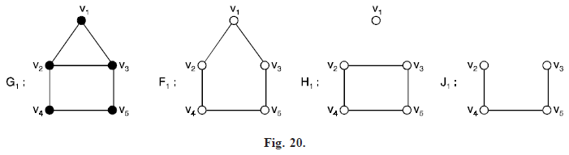

Slide 28
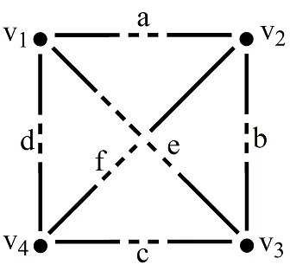
Isomorphic graph:
Graph G = G(V,E) and graph H = H(V’,E’) are said to be isomorphic if there
exists one to one correspondence f : V -> V’ such that (u,v) is an edge in G if and only
If {f(u),f(v)} is an edge in H.

Slide 29
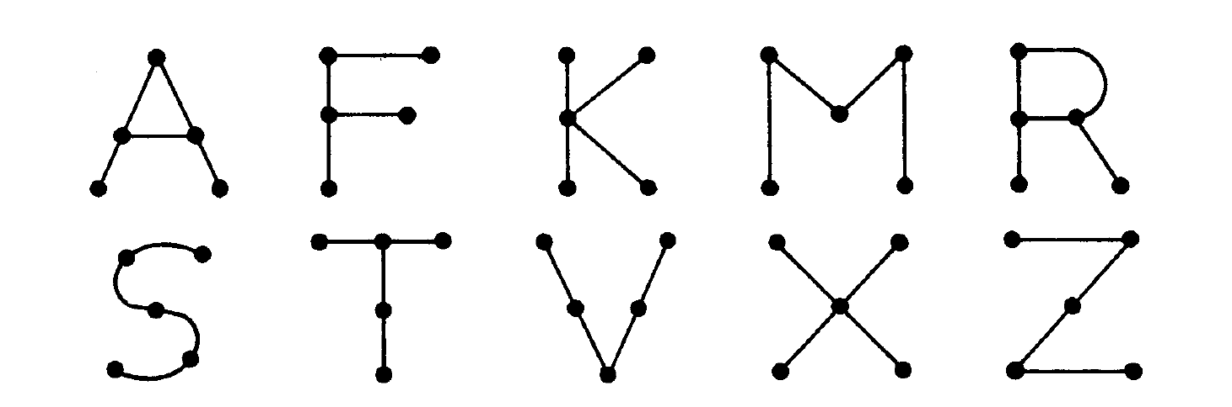

Slide 30
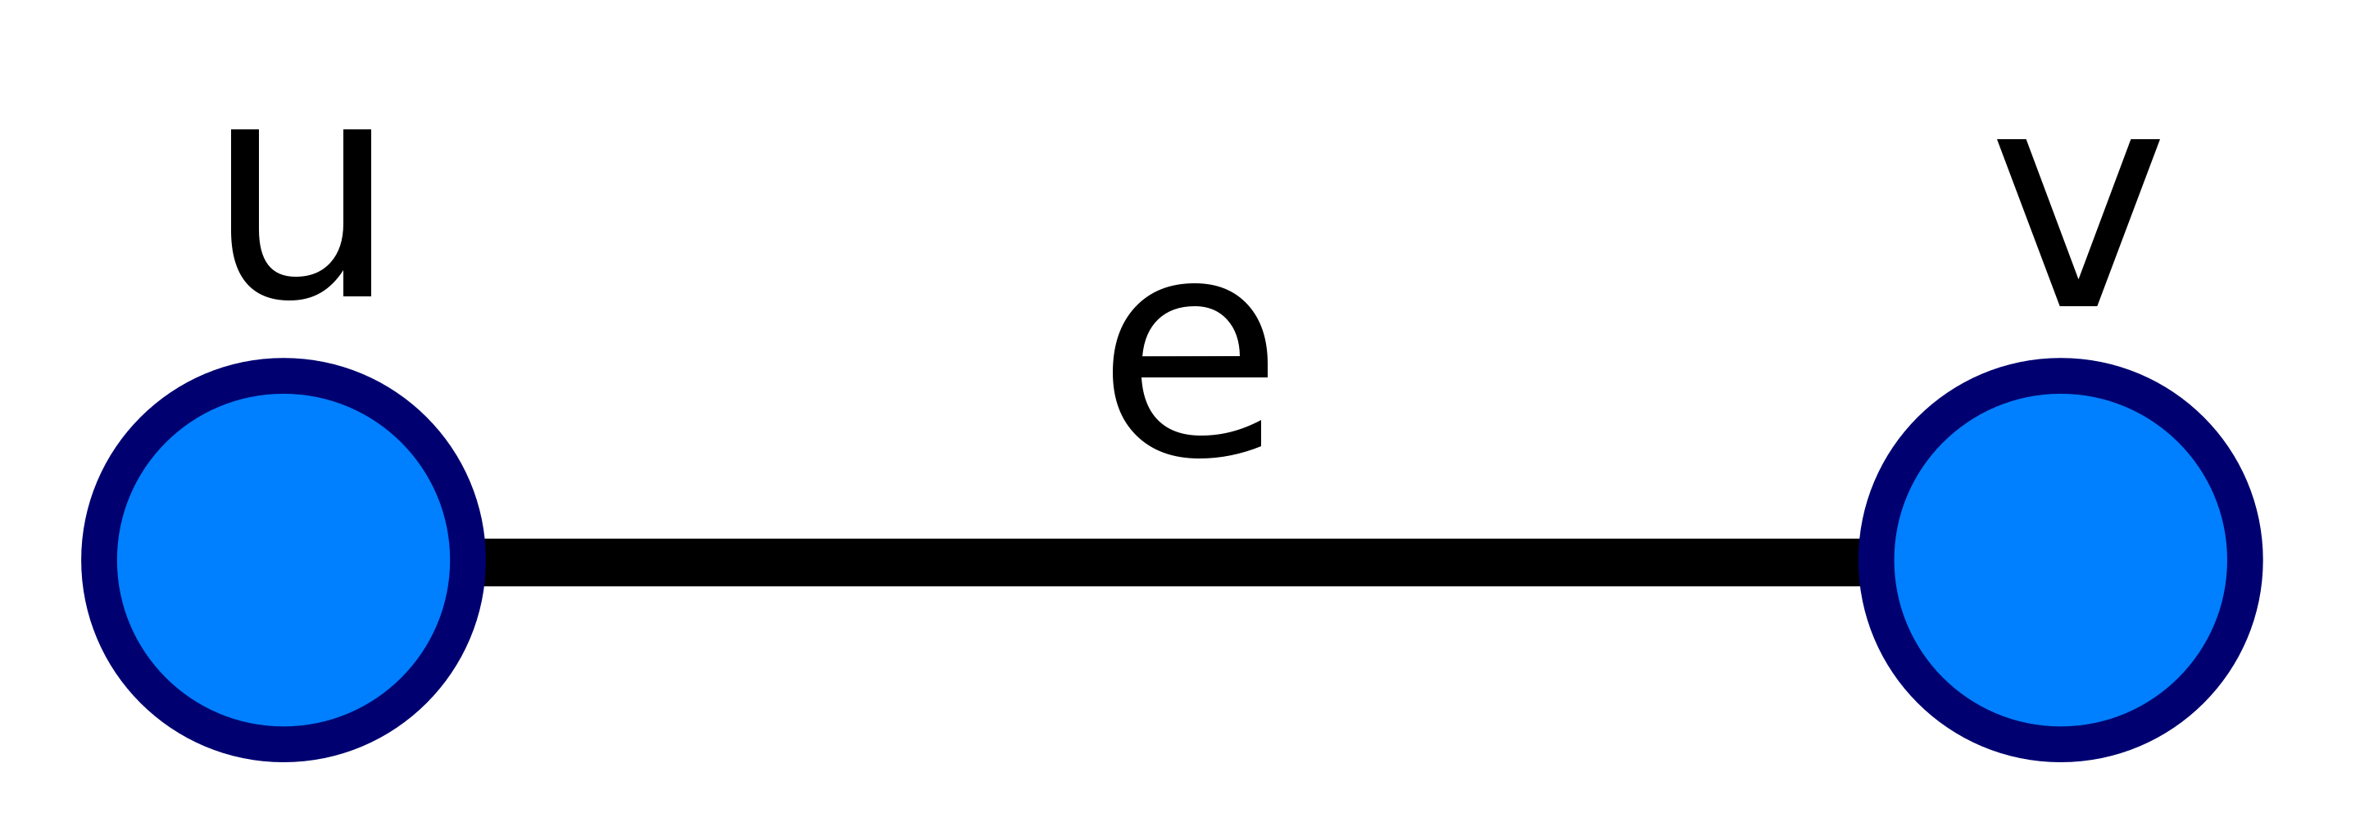
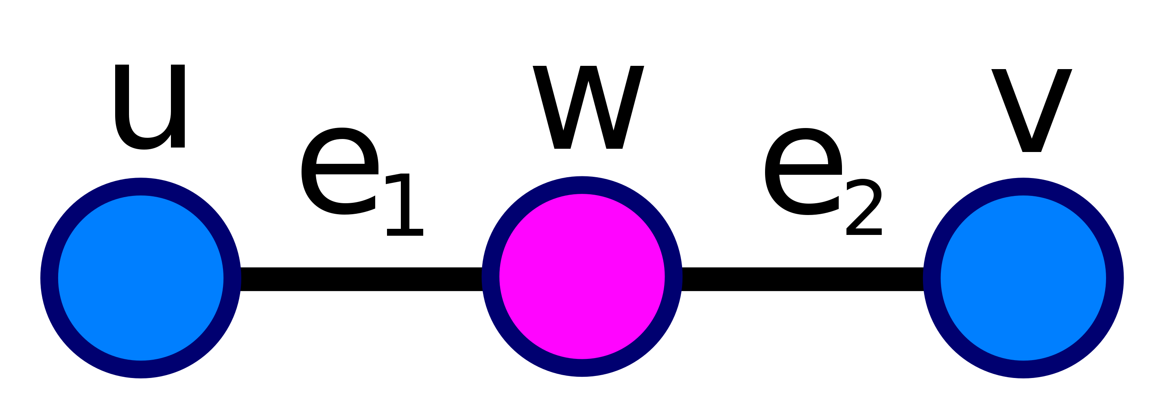
Homeomorphic graph:
Graph G = G(V,E) and graph G’ = G’(V’,E’) are said to be homeomorphic if they can be
obtained from the same graph or isomorphic graphs. In other words, two graphs G and G’ are homoeomorphic if there is a graph isomorphism from some subdivision of G to some subdivision of G’
In general, a subdivision of a graph G is a graph resulting from the subdivision of edges in G. The subdivision of some edge e with endpoints {u,v } yields a graph containing one new vertex w, and with an edge set replacing e by two new edges, {u,w } and {w,v }.
For example, the edge e, with endpoints {u,v }:
an be subdivided into two edges, e1 and e2, connecting to a new vertex w:

Slide 31
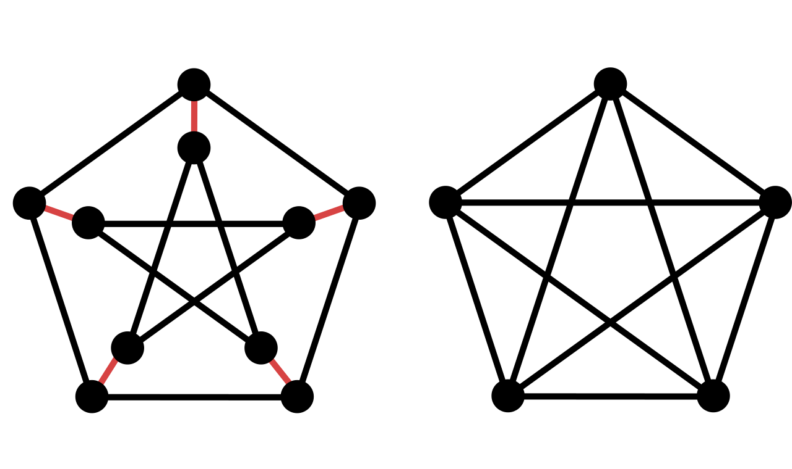
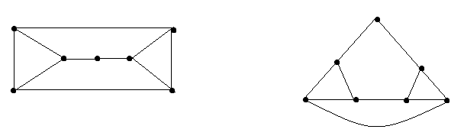

Slide 32
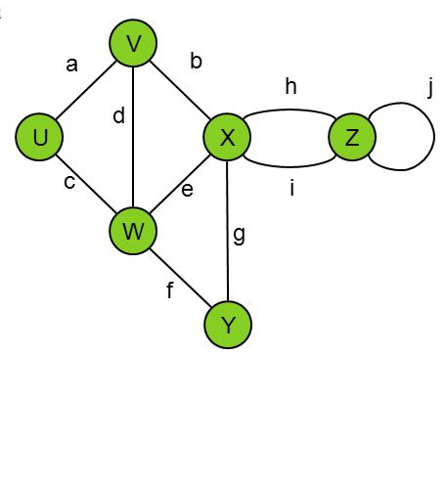

Slide 33
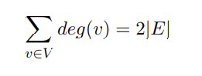
Theorem 8.1: The sum of the degrees of the vertices of a graph G is equal to twice the number of edges in G.
Proof:
Base Case: m = 0
Let G be an arbitrary graph with n vertices and 0 edges. Note that the degree of each vertex in
the graph must be 0, since there are no edges. Thus, the sum of the degree of all of the vertices
must also be 0.
Induction Hypothesis:
Assume that, for some k ∈ N, an arbitrary graph with n vertices and k edges has the following
property:

Slide 34
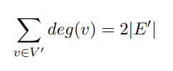
Induction Step:
Let G(V, E) be an arbitrary graph with n vertices and k + 1 edges. Consider the graph G(V’,E’) that is the graph constructed by removing an arbitrary edge e = {u, v} from G. Note that G’ is agraph with n vertices and k edges. By the Induction Hypothesis, we know that:

Slide 35
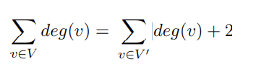
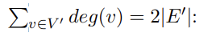
Let us consider what happens when we add e back. Note that the addition of e increases the degree
of u by 1 and the degree of v by 1, and does not affect the degree of any other vertex. So, we know
that the sum of the degrees of all of the vertices should increase by 2.
Hence, we have that:
By the Induction Hypothesis, we have that
= 2|E’| + 2
= 2 ( |E’| + 1 )
But we know that |E’| = |E| − 1 since we removed one edge from G to construct G’ :
= 2(|E| − 1 + 1)
= 2|E|

Slide 36
Paths
A path in a multigraph G consists of an alternating sequence of vertices and edges of the form
v₀, e₁, v₁, e₂, v₂, . . . , e_{n−1}, v_{n−1}, e_{n}, v_{n}
where each edge e_{i} contains the vertices v_{i−1} and v_{i} (which appear on the sides of e_{i} in the sequence). When there is no ambiguity, we denote a path by its sequence
of vertices (v₀, v₁, . . . , v_{n})
Length of a path :
The number n of edges is called the length of the path. When there is no ambiguity, we denote a path by its sequence of vertices (v₀, v₁, . . . , v_{n}).

Slide 37
Closed Path:
A path is said to be closed if v₀=v_{n}
Simple Path:
A path is said to be simple if all the vertices are distinct
Cycle:
A cycle is a closed path in which all the vertices are distinct except v₀=v_{n}
k-cycle:
A cycle of length k is called k-cycle

Slide 38
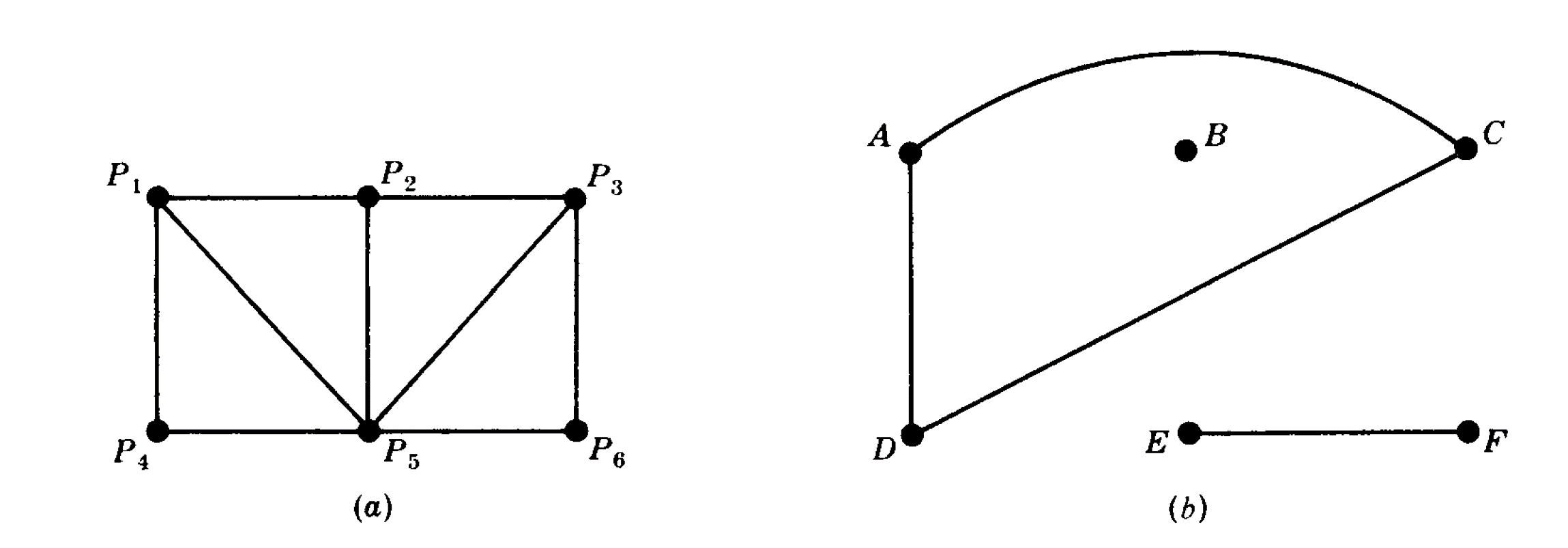
Connectivity
Connected Graph:
A graph G is connected if there is path between any two of its vertices.

Slide 39
Connected component :
Suppose G is a graph. A connected subgraph H of G is called a connected component of G if H is not contained in any larger connected subgraph of G.
Connected component of this graph are??

Slide 40
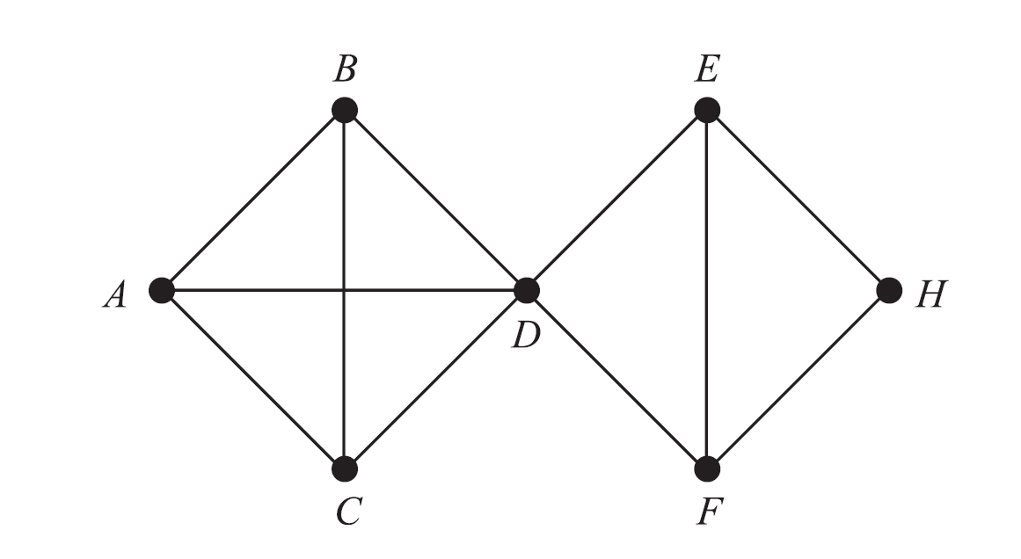
Distance and Diameter
Distance:
Consider a connected graph G. The distance between vertices u and v in G, written d(u, v), is the length of the shortest path between u and v.
d(A,F) = 2

Slide 41
Diameter:
Consider a connected graph G. The diameter of G, written diam(G), is the maximum distance between any two points in G.
diam(G) = 3

Slide 42
Cut points and bridges
Cutpoint:
Let G be a connected graph. A vertex v in G is called a cutpoint if G−v is disconnected. (Recall that G−v is the graph obtained from G by deleting v and all edges containing v.).
Bridges :
An edge e of G is called a bridge if G−e is disconnected. (Recall that G − e is the graph obtained from G by simply deleting the edge e).

Slide 43
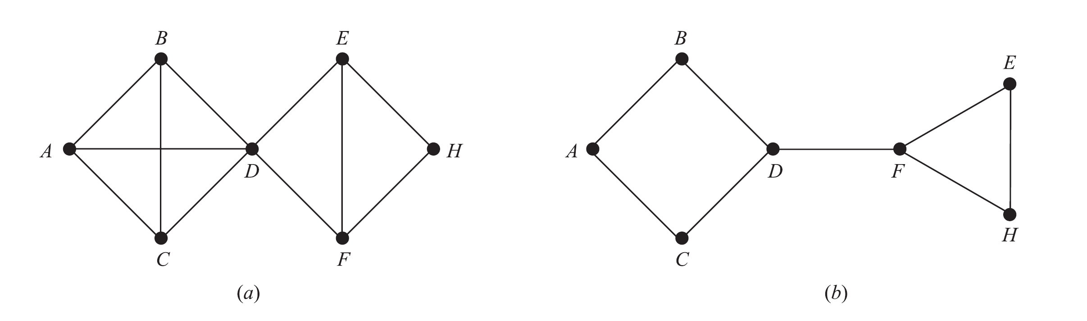
The edge = {D,F} is a bridge. (Its endpoints
D and F are necessarily cutpoints.)
The vertex D is a cutpoint and there are no bridges.

Slide 44
Euler Graph and Circuit
Traversable Multigraph:
A multigraph is said to be traversable if it “can be drawn without any breaks in the curve and without repeating any edges,” that is, if there is a path which includes all vertices and uses each edge exactly once.
Such a path must be a trail (since no edge is used twice) and will be called a
traversable trail. Clearly a traversable multigraph must be finite and connected.

Slide 45
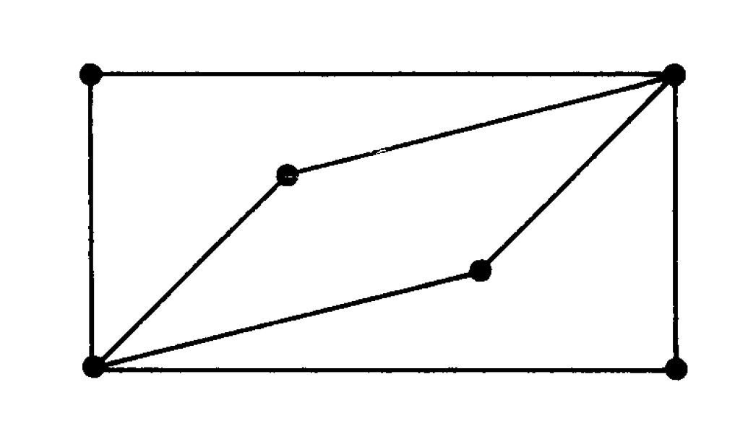
Euler Graph:
A graph G is called an Eulerian graph if there exists a closed traversable trail, called an Eulerian trail.

Slide 46
Hamiltonian Graph and circuit
Hamiltonian Circuit:
Hamiltonian circuit in a graph G(named after the nineteenth-century Irish mathematician William Hamilton (1803–1865)) is a closed path that visits every vertex in G exactly once. (Such a closed path must be a cycle.)
Hamiltonian Graph:
If G does admit a Hamiltonian circuit, then G is called a Hamiltonian graph.

Slide 47
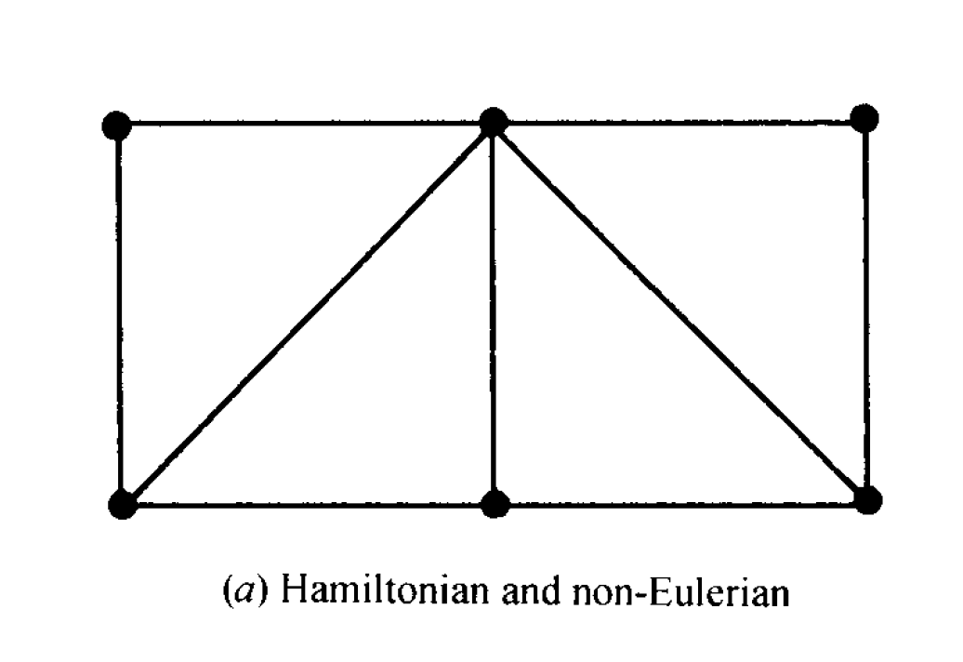

Slide 48
Labelled Graph and Weighted Graph
Labelled graph:
A graph G is called a labeled graph if its edges and/or vertices are assigned data of one kind or another. In particular, G is called a weighted graph if each edge e of G is assigned a nonnegative number w(e) called the weight or length of v.
Weighted Graph:
If G does admit a Hamiltonian circuit, then G is called a Hamiltonian graph.

Slide 49
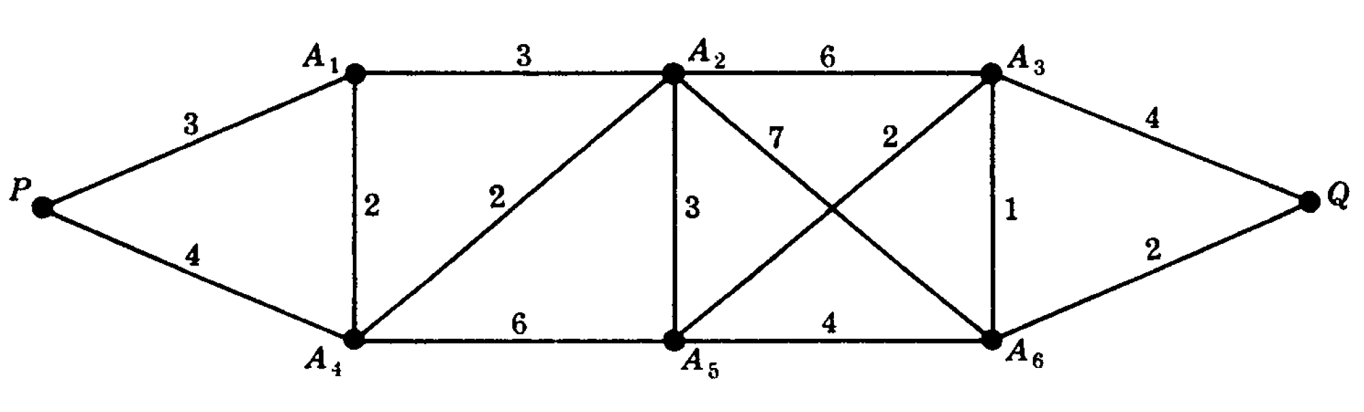

Slide 50
Complete, Regular and Bipartite graph
Complete graph:
A graph G is said to be complete if every vertex in G is connected to every other vertex in G. Thus a complete graph G must be connected. The complete graph with n vertices is denoted by K_{n}.

Slide 51
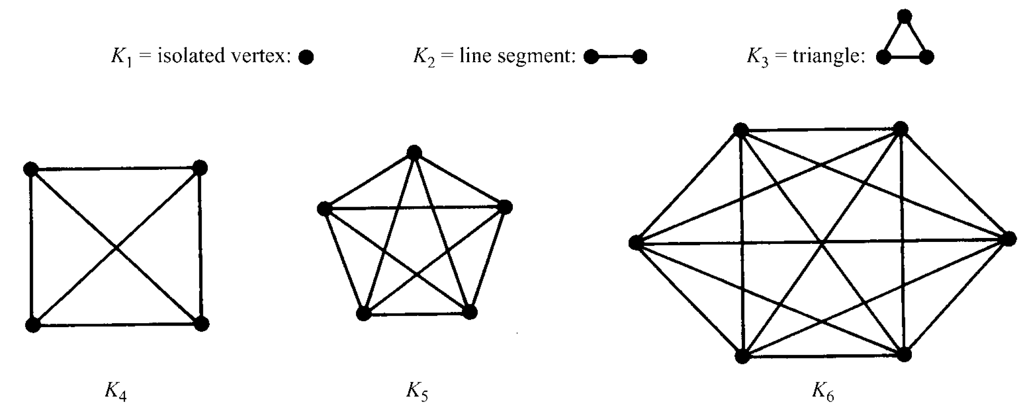

Slide 52
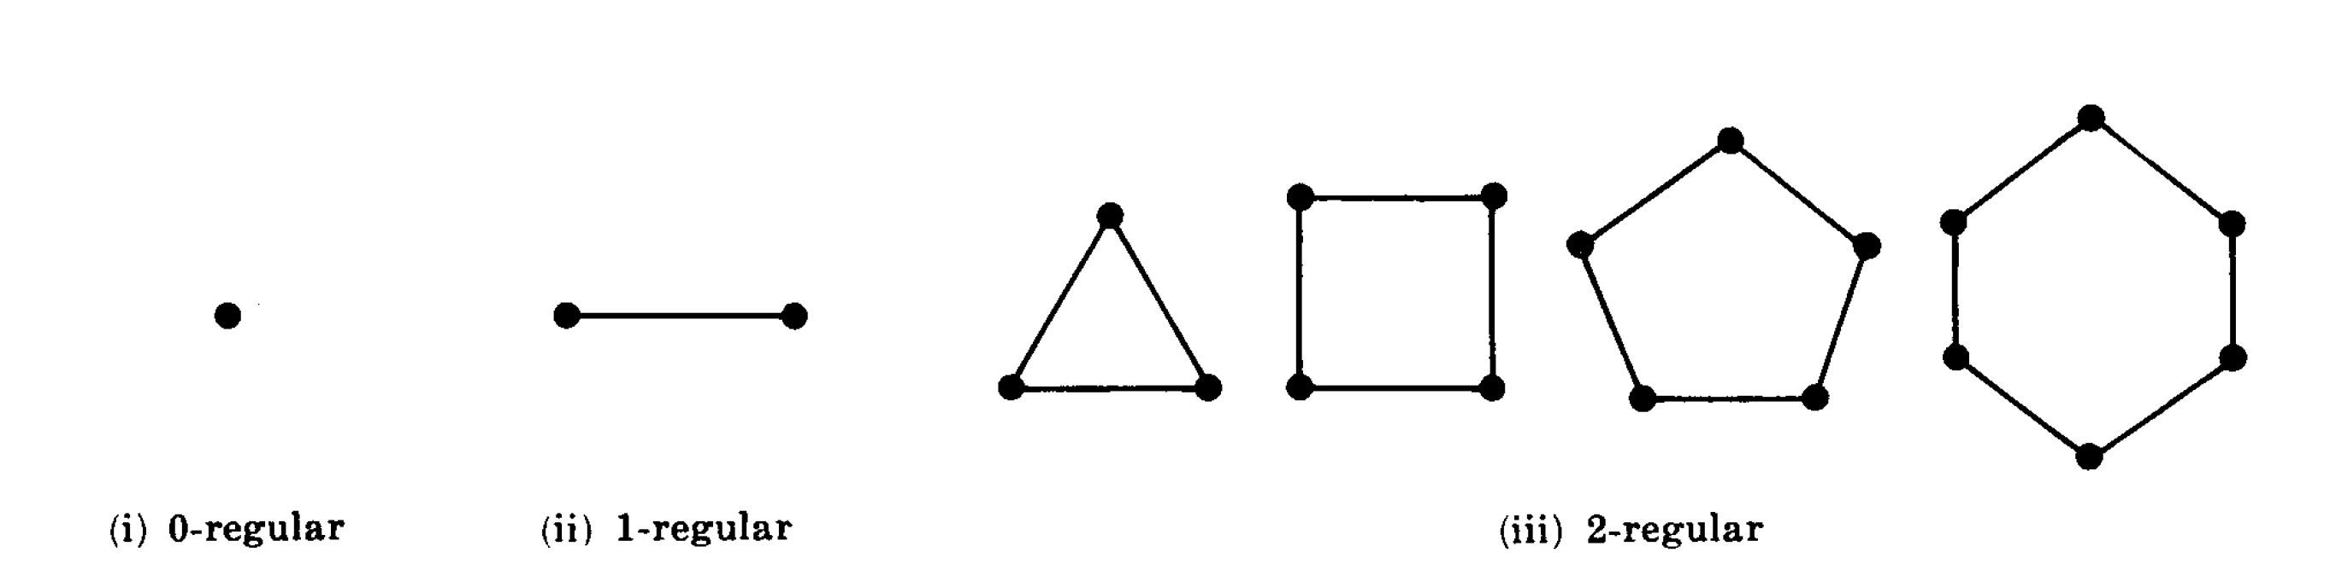
Regular graph:
A graph G is regular of degree k or k-regular if every vertex has degree k. In other words, a graph is regular if every vertex has the same degree.

Slide 53
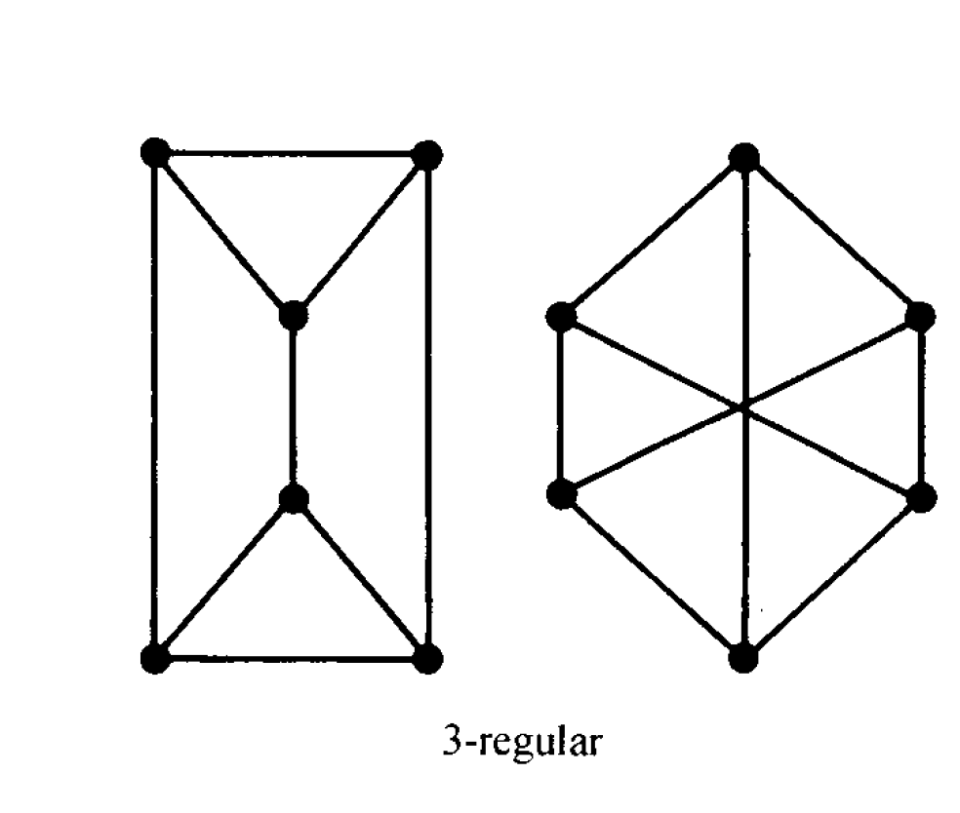

Slide 54
Bipartite Graph:
A graph G is said to be bipartite if its vertices V can be partitioned into two subsets M and N such that each edge of G connects a vertex of M to a vertex of N.
Complete bipartite Graph :
By a complete bipartite graph, we mean that each vertex of M is connected to each vertex of N; this graph is denoted by Km,n where m is the number of vertices in M and n is the number of vertices in N, and, for standardization, we will assume
m ≤ n.

Slide 55
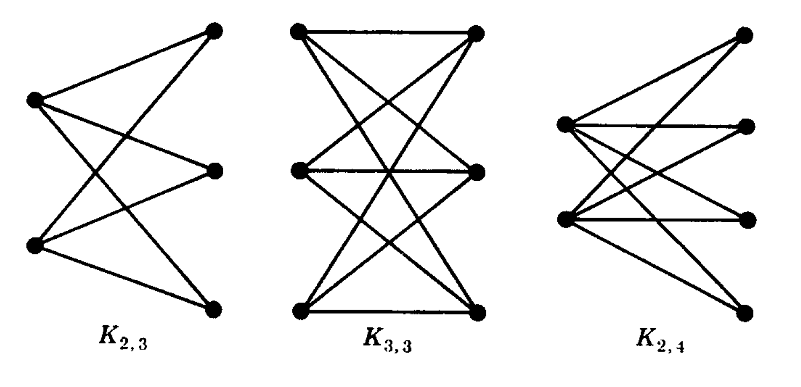

Slide 56
Complement of a Graph
Multiple edges:
Edges having same pair of endpoints
Clique:
A clique in a graph G is a set of pairwise adjacent vertices.
Independent set:
An independent set(or stable set) in a graph is a set of pairwise non-adjacent vertices.

Slide 57
Complement :
Complement G’(V’,E’) of a Graph G(V,E) is a simple graph with vertex set V’= V and edge set E’(G’) defined by uv € E’(G’) if and only if uv € E(G)
Null Graph:
A graph with no vertex is called a null graph.

Slide 58
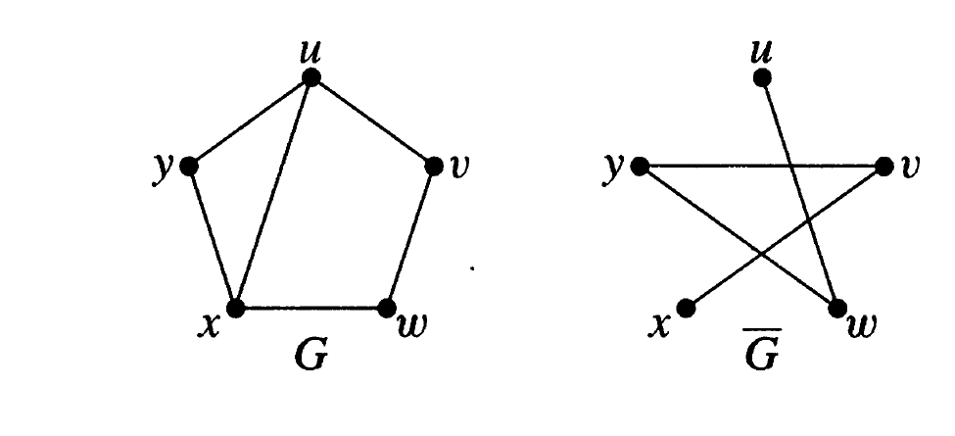

Slide 59
Planar Graphs
Planar Graphs:
A graph or multigraph which can be drawn in a plane so that its edges do not cross is said to be a planar Graph
Map:
A particular planar representation of a finite planar multigraph is called a map

Slide 60
Region:
A map divides the plane into several areas called regions.
Euler’s Formula:
If V be the number of vertices, E be the number of edges and R be the number of regions in a map then –
V – E + R = 2

Slide 61
Graph Colorings
Vertex coloring/coloring:
Given a graph G(V,E). A vertex coloring or coloring of G is assignment of colors to the vertices of G such thatadjacent vertices have different colours
Chromatic number:
The minimum number of colors needed to paint G is called its chromatic number.

Slide 62
Representing Graphs in Computer Memory
Adjacency Matrix:
Suppose G is a graph with m vertices and suppose the vertices have been ordered, say v₁,v₂,v₃,….,v_{m}. Then the adjacency matrix A = [a_{ij}] of the graph G is a m x m matrix defined by –
a_{ij} = 1 if v_{i} is adjacent to v_{j}
0 otherwise

Slide 63
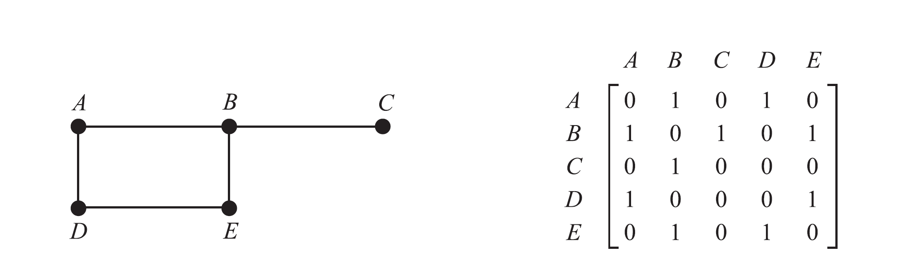

Slide 64
Incidence Matrix:
Suppose G is a graph with m vertices and suppose the vertices have been ordered, say v₁,v₂,v₃,….,v_{m}. Then the incidence matrix M = [m_{ij}] of the graph G is a n x m matrix defined by –
m_{ij} = 1 if v_{i} is endpoint to e_{j}
0 otherwise

Slide 65
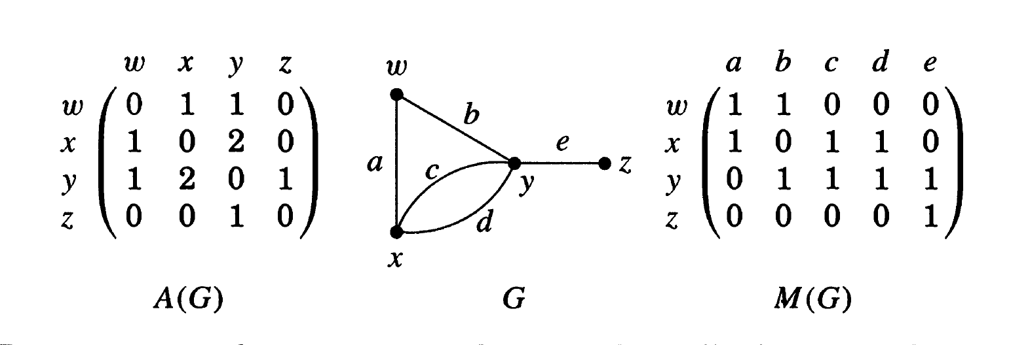

Slide 66
K-partite
Self complementary
Decomposition
Degree sequence

